Slide 1
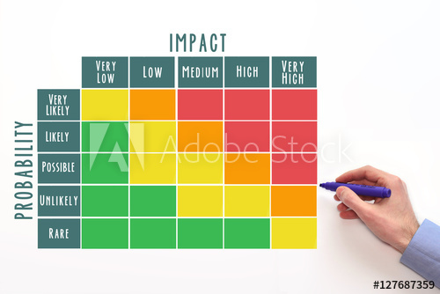
Viz Notes:
Splash Screen
Frame 1
Slide 1 of 3
Layout: 50:50 Slide
Treatment: Show the given image on the left or on full screen and add text in sync with audio.
Image source:
https://stock.adobe.com/in/images/probability-and-impact-matrix/127687359
Risk assessment tools can make us less vulnerable.
Notes:
<AX1>
Did you know risk assessment tools make us less vulnerable...

Slide 2

Viz Notes:
Splash Screen
Frame 1
Slide 2 of 3
Layout: 50:50 Slide
Treatment: Show the given image on the left or on full screen and add text in sync with audio.
Image source:
https://as1.ftcdn.net/jpg/01/16/02/20/500_F_116022071_yETsXAcWU6f19YFdbwD9RiA5nb9rSOOH.jpg
Risk assessment tools increase community participation.
Notes:
<AX2> …and these tools increase community participation?

Slide 3

Viz Notes:
Splash Screen
Frame 1
Slide 3 of 3
Layout: 50:50 Slide
Treatment: Show the given image on the left or on full screen and add text in sync with audio.
Image source:
https://t4.ftcdn.net/jpg/02/48/21/89/240_F_248218962_Db3o6NNpMNtM2lgi0e7iQK65x9zKjMDn.jpg
Risk assessment tools help to avoid hazards and keep the community safe.
Notes:
<AX3>
Risk assessment tools help to avoid hazards and keep the community safe.
<AX4>
Today we are going to learn about this, and more!

Slide 4

Session Title
Viz. notes:
Frame: 2
This is a Welcome screen.
This is slide 1 of 1
Layout Name: 1.1 Welcome Layout
External Image:
https://www.shutterstock.com/image-photo/image-tangram-puzzle-blocks-people-icons-1149593039
Treatment:
The background image appears on screen load.
The module name appears in sync with AX1.
This slide should automatically transition to the next.
Risk Assessment Tools Session
Notes:
<AX1> Welcome to the session, “Risk Assessment Tools Session.”

Slide 5




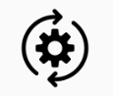
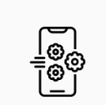
Learning Objectives
Viz. notes:
Frame: 3
Learning Objectives
Slide 1 of 1
Layout Name: Learning Objectives
External Icons:
https://static.thenounproject.com/png/2064324-200.png
https://static.thenounproject.com/png/3000289-200.png
https://static.thenounproject.com/png/2965944-200.png
https://static.thenounproject.com/png/2208338-200.png
https://stock.adobe.com/in/images/dartscheibe/177128369
Treatment:
Follow the same strategy as in other courses.
On completion of audio, the Next button activates, and the learner can proceed to the Next frame.
Splash Game
Learning Objectives
When you have completed this session, you will be able to:
Identify different tools used in risk assessment.
Explain the purpose of each assessment tool.
List the process of each assessment tool.
Understand the characteristics of each assessment tool.
Notes:
<AX1> When you have completed this session, you will be able to:
Identify different tools used in risk assessment;
Explain the purpose of each assessment tool;
List the process of each assessment tool; and
Understand the characteristics of each assessment tool.

Slide 6

Different Tools Used for Risk Assessment | Vulnerability Capacity Assessment (VCA)
Viz. notes:
Frame: 4
Content Slide
Slide 1 of 4
Layout Name: Create as is.
External Icons:
https://stock.adobe.com/in/images/risk-assessment-business-symbols-grey-texture-blue-stripes/294588030
Treatment:
Sync AX1 with the image and the AX2 with the OST.
Vulnerability Capacity Assessment = VCA
Notes:
<AX1> There are many tools that help in risk assessment.
<AX2> One such tool is the Vulnerability Capacity Assessment or VCA.

Slide 7



Different Tools Used for Risk Assessment | Vulnerability Capacity Assessment (VCA)
Viz. notes:
Frame: 4
Content Slide
Slide 2 of 4
Layout Name: Create as is
External Icons:
https://t3.ftcdn.net/jpg/02/01/21/06/240_F_201210614_TSvEGHNmxhILRjAJ2ocrAY9IObREx67H.jpg
https://t3.ftcdn.net/jpg/03/16/39/90/240_F_316399070_PBJPBUGe4A9YBElmhuZ2IygOqBiewgfC.jpg
https://t3.ftcdn.net/jpg/03/00/40/02/240_F_300400232_s5emwqpDMuPFejKSUm8uflf1B76rsROa.jpg
Treatment:
Please display the image sin sync with AX3. Start from the top to bottom with the OST.
Community Level
Household Level
Individual Level
Notes:
<AX3> The VCA starts with identification of general information at the community level and scales down to the household and the individual levels.

Slide 8


Different Tools Used for Risk Assessment | Vulnerability Capacity Assessment (VCA)
Viz. notes:
Frame: 4
Content Slide
Slide 3 of 4
Layout Name: Create as is
External Icons:
https://t4.ftcdn.net/jpg/03/03/54/91/240_F_303549148_ZSWTgG2eYOOkNw9u5zQfUGWs6wi5Tgus.jpg
https://t3.ftcdn.net/jpg/03/29/27/26/240_F_329272690_ajV6vtTyU4ZfKuATFh7JxZXRapw5WHUx.jpg
Treatment:
Please display the image sin sync with AX4. After the audio finishes enable next.
Notes:
<AX4> The VCA consists of various methods and tools, which have their use determined by the time of conducting the VCA.

Slide 9
Different Tools Used for Risk Assessment | Vulnerability Capacity Assessment (VCA)
Viz. notes:
Frame: 4
Content Slide
Slide 4 of 4
Layout Name: Recreate the chart
Image: Recreate from source ppt
Treatment:
Please display the recreated chart in sync with AX5. After the audio finishes, enable Next.
General information on community level
Review of secondary data, particularly regional/provincial information related to hazards, risks, vulnerabilities, and capacities
Historical Profile Mapping Transect
Seasonal Calendar
Institutional and Social Network Analysis
Health and Nutritional Assessment
Livelihoods/Coping analysis
Problem tree
Ranking
VCA
Specific information at community, household, and individual level
VCA results
Notes:
<AX5> The provided sequence can be followed with modification as required, starting with review of secondary data and ending by ranking the identified problems and their causes.

Slide 10
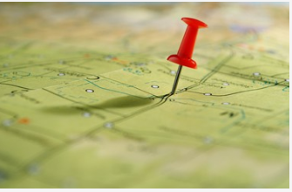
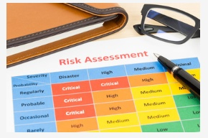
Different Tools Used for Risk Assessment | Mapping
Viz. notes:
Frame: 5
Content Slide
Slide 1 of 4
Layout Name: 50:50
External Icons:
https://t3.ftcdn.net/jpg/01/31/94/86/240_F_131948630_9R0tcMng9ZOte1Bdg3vfLpIzmfd5b4Cb.jpg
https://t3.ftcdn.net/jpg/00/38/50/24/240_F_38502426_6UCJqeGvB0bYYqsMxvxrJ8PT2zROex4a.jpg
Treatment:
Sync the images with AX1. With audio ‘assessment’ show 1st image. With audio ‘mapping’ show the 2nd image.
After the audio finishes, enable Next.
Notes:
<AX1> Let’s move on to the next assessment tool known as mapping.

Slide 11
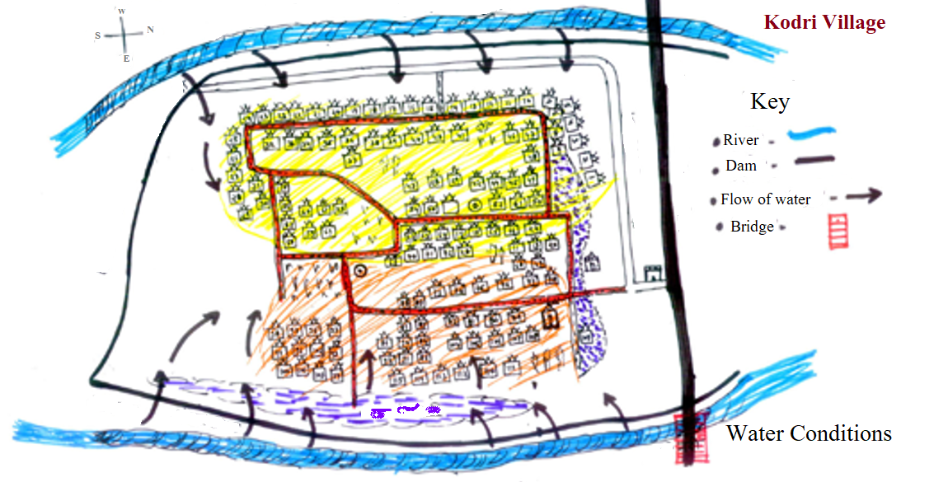
Different Tools Used for Risk Assessment | Mapping
Viz. notes:
Frame: 5
Content Slide
Slide 2 of 4
Layout Name: Recreate from source ppt.
Treatment:
Please recreate the image, sync it with the AX2.
Notes:
<AX2> In Mapping, the community members and the assigned VCA group with the facilitation of experts, draw a map profile of their areas to identify different vulnerable factors and the available resources.

Slide 12
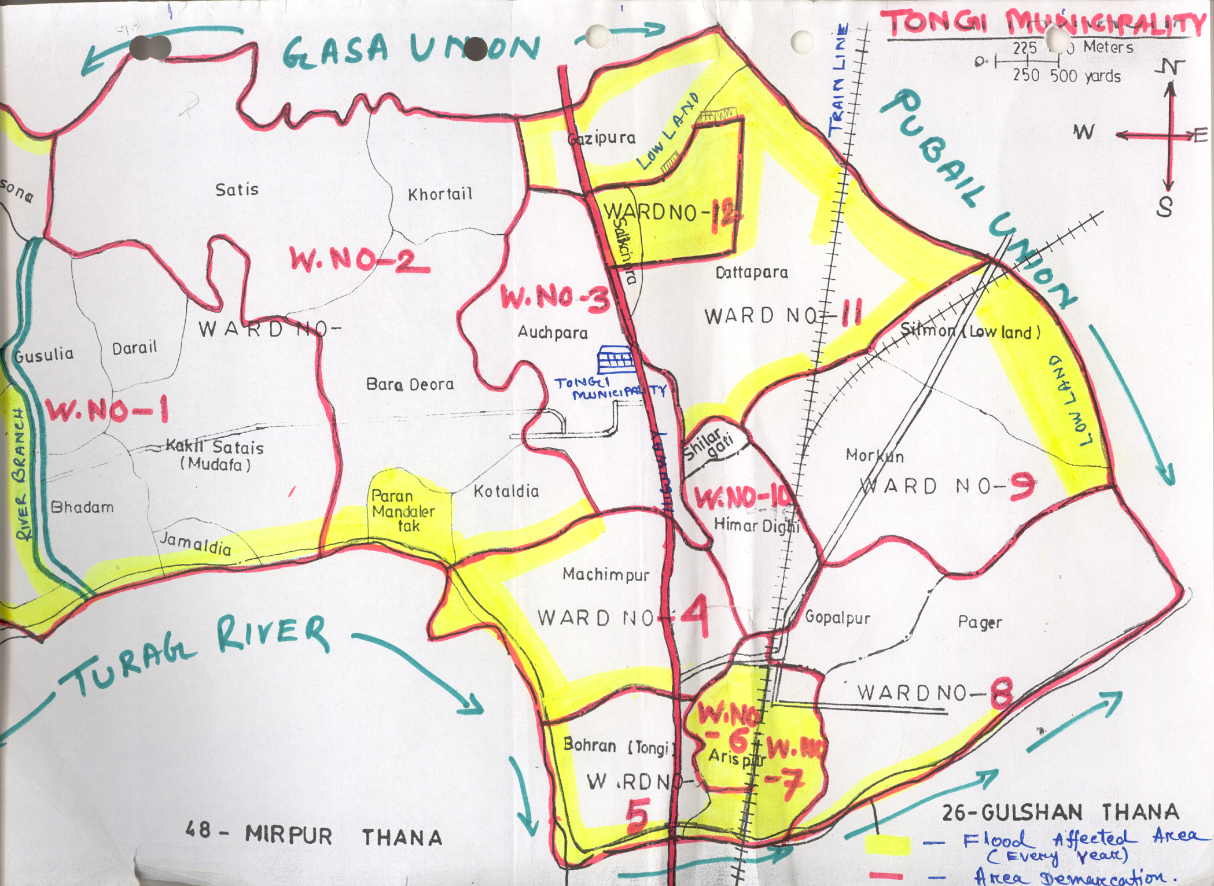
Different Tools Used for Risk Assessment | Mapping
Viz. notes:
Frame: 5
Content Slide
Slide 3 of 4
Layout Name: Recreate
Treatment:
Sync the chart with AX3.
Notes:
<AX3> This is similar to a multi-layer GIS map for used risk mapping.

Slide 13
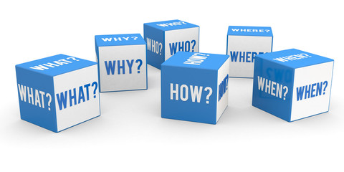
Different Tools Used for Risk Assessment | Mapping: Process
Viz. notes:
Frame: 6
Slide 1 of 7
Layout Name: 5 Tab Interactivity (shown on next slide)
Slide 14 Reference
Treatment:
Please appear the image and OST in sync with AX4.
Mapping as a tool for risk assessment.
Notes:
<AX1> When you are taking up mapping as a tool for risk assessment, you need to find the solutions to the following questions:

Slide 14

Different Tools Used for Risk Assessment | Mapping: Process
Viz. notes:
Frame: 6
Slide 2 of 7
Treatment:
Fade the image in the backdrop. Then appear the tabs in sync with the audio AX2.
Sync the instruction with IAX.
What
Why
When
Who
How
Click each tab to know more.
Notes:
<AX2>
What;
Why;
When;
Who; and
How.
<IAX> Click each tab to know more.

Slide 15
Different Tools Used for Risk Assessment | Mapping: Process
Viz. notes:
Frame: 6
Slide 3 of 7
What
Why
When
Who
How
Make a spatial overview of the area’s main features.

Slide 16
Different Tools Used for Risk Assessment | Mapping: Process
Viz. notes:
Frame: 6
Slide 4 of 7
What
Why
When
Who
How
Using mapping as a tool for assessment makes it easy to facilitate communication and stimulate discussions. Maps can be drawn for many topics:
Spatial arrangement of houses, fields, roads, rivers, and other land uses
Hazard map
Elements at risk
Resource map showing local capacities
Mobility map

Slide 17
Different Tools Used for Risk Assessment | Mapping: Process
Viz. notes:
Frame: 6
Slide 5 of 7
What
Why
When
Who
How
Asses the initial phase of community risk.

Slide 18
Different Tools Used for Risk Assessment | Mapping: Process
Viz. notes:
Frame: 6
Slide 6 of 7
What
Why
When
Who
How
Planning should be done by community members.

Slide 19
Different Tools Used for Risk Assessment | Mapping: Process
Viz. notes:
Frame: 6
Slide 7 of 7
What
Why
When
Who
How
How do you do take up risk assessment?
Decide about the type of map to be drawn.
Find men, women who know the area, and willing to share experiences.
Choose a suitable place (ground, floor, paper) and medium (stick, stones, seeds, pencils, chalk) for the map.
Help the people get started but let them draw the map by themselves.
Use questions to facilitate development of map.

Slide 20


Different Tools Used for Risk Assessment | Seasonal Calendar
Viz. notes:
Frame: 7
Slide 1 of 2
Layout Name: 50:50
External Image:
https://stock.adobe.com/in/images/word-writing-text-reduce-risk-business-photo-showcasing-lessen-the-potential-damage-that-could-be-caused-by-a-hazard/318673963
https://t3.ftcdn.net/jpg/02/66/04/84/240_F_266048471_iDlz969Vqo7THGR4p8m0nOh1TfgwwXBV.jpg
Treatment:
Show the images with AX1 in sync with audio terms ‘risk’ and ‘seasonal’ respectively.
Notes:
<AX1> Next, let us know about another risk assessment tool known as seasonal calendar.

Slide 21
Different Tools Used for Risk Assessment | Seasonal Calendar
Viz. notes:
Frame: 8
Slide 2 of 2
Layout Name: Same as shown.
External Image: Recreate from source ppt.
Treatment:
Show the recreated chart with AX2.
J F M A M J J A S O N D
Flood
Drought
Charcoal making
Busiest season
Notes:
<AX2> The seasonal calendar, as the name suggests, shows different events, experiences, activities, conditions throughout the annual cycle.

Slide 22



Different Tools Used for Risk Assessment | Seasonal Calendar: Characteristics
Viz. notes:
Frame: 9
Slide 1 of 4
Layout Name: 3 image interactivity
https://static.thenounproject.com/png/1780267-200.png
https://static.thenounproject.com/png/952287-200.png
https://static.thenounproject.com/png/1049522-200.png
Treatment:
Sync the instruction with IAX. Show the tabs loading with AX1.
Click each image to know more.
Notes:
<AX1> While planning a seasonal calendar, there are certain characteristics that should be kept in mind. Let us know about each of them in detail.
<IAX> Click each image to know more.

Slide 23
Different Tools Used for Risk Assessment | Seasonal Calendar: Characteristics
Viz. notes:
Frame 9
Slide 2 of 4
The first question is knowing why is the seasonal calendar needed. Start with identifying:
Periods of stress, hazards, diseases, hunger, vulnerability, etc.
What people do in these periods?
How they diversify sources of livelihood?
When do they have savings?
When do they have time for community activities?
What are their coping strategies?
Gender specific division of work in times of disasters and in normal times.
Click each image to know more.

Slide 24
Different Tools Used for Risk Assessment | Seasonal Calendar: Characteristics
Viz. notes:
Frame 9
Slide 3 of 4
The next big challenge is understanding who will take up the task of making the seasonal calendar. Mostly community members are made into teams for taking up the task.
Click each image to know more.
Notes:
<AX3>

Slide 25
Different Tools Used for Risk Assessment | Seasonal Calendar: Characteristics
Viz. notes:
Frame 9
Slide 4 of 4
Last question is how to go about it. Start by using a ‘blackboard’ or craft paper, mark off the months of the year on the horizontal axis.
Ask people to list sources of livelihood, events, conditions, etc., and arrange all these factors along the vertical axis.
Ask people to enumerate all the work they do like ploughing, planting, and weeding. For each source of income, mark months and duration along with adding the gender and age.
Facilitate analysis by linking the different aspects of the calendar. Think about questions such as how do disasters affect sources of livelihood? When is the workload heaviest?
Ask for seasonal food intake. Know when is the period of food shortage, out-migration, and other factors that can affect the food intake.
Discuss the coping strategies.
Change in gender roles and responsibilities during times of disasters, or other issues you think are relevant.
Click each image to know more.

Slide 26
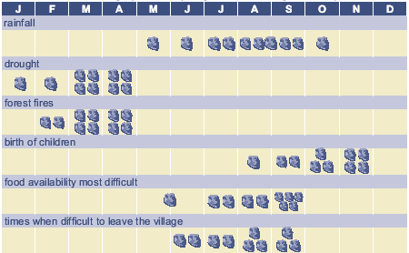
Different Tools Used for Risk Assessment | Seasonal Calendar: Example
Viz. notes:
Frame 10
Slide 1 of 1
Image: Take from source ppt
Treatment:
Sync the recreated chart with AX1.
Notes:
<AX1> Here is an example of how the seasonal calendar looks like.

Slide 27
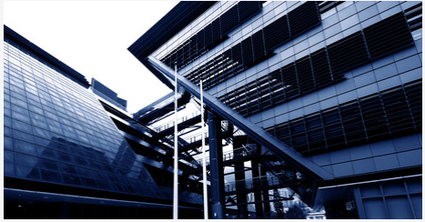

Different Tools Used for Risk Assessment | Seasonal Institutional and Social Network Analysis using Venn Diagram
Viz. notes:
Frame: 11
Slide 1 of 1
Layout Name: 50:50
External Image:
https://t3.ftcdn.net/jpg/00/27/10/84/240_F_27108401_BSN5Xp2sRfVacDs1uSirNmCwzglgdTpf.jpg
https://t3.ftcdn.net/jpg/02/95/78/28/240_F_295782805_BkQaZflFJqDx4UqDEADc5OJViU53ktpl.jpg
Treatment:
Sync the images with AX1. This is a transition slide.
Institutional and Social Network Analysis
Notes:
<AX1> Next on the list is the Institutional and Social Network Analysis using a Venn Diagram.

Slide 28


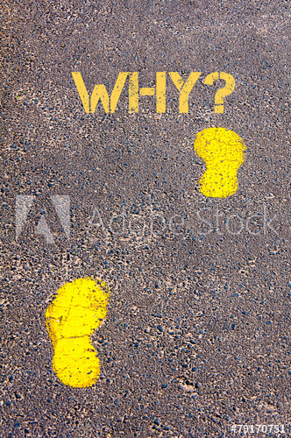
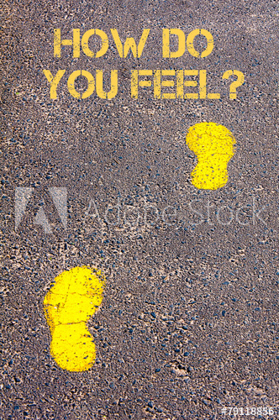

Different Tools Used for Risk Assessment | Seasonal Institutional and Social Network Analysis using Venn Diagram: Characteristics
Viz. notes:
Frame: 12
Slide 1 of 5
Layout Name: 4 tab interactivity
External Image:
https://stock.adobe.com/in/images/yellow-footsteps-on-sidewalk-towards-what-message/79172418
https://stock.adobe.com/in/images/yellow-footsteps-on-sidewalk-towards-when-message/79172426
https://stock.adobe.com/in/images/yellow-footsteps-on-sidewalk-towards-why-message/79170751
https://as1.ftcdn.net/jpg/00/79/11/88/500_F_79118856_J5wm3z8mVSE0boCgnkQjlKEWhJ3kTKAd.jpg
Treatment:
With AX1, show all the 4 tabs. Sync the itext with IAX.
Click each image to know more.
Notes:
[AX1] Let’s look at some characteristics of Institutional and Social Network Analysis using a Venn Diagram.
<IAX> Click each image to know more.

Slide 29
Different Tools Used for Risk Assessment | Seasonal Institutional and Social Network Analysis using Venn Diagram: Characteristics
Viz. notes:
Frame: 12
Slide 2, 3, 4, 5 of 5
Know in advance, names of organizations:
Ask group to determine criteria for importance of an organization or individual
Ask group about level and type of linkages amongst organizations
Draw circles to represent each institution, group or individual;
Distance and overlap shows level of interaction amongst organizations
Continue discussion by asking questions on history, actions taken by organization, coordination amongst organizations, and people’s perception of organizations that can be relied on during disasters.
The most important step is to understand the need of the diagram.
The diagram shows key-organizations, groups, and individuals in a community and their nature of relationship and level of importance.
A team and community members are chosen to take up the analysis.
The bigger question is why do we need it.
Institutional and Social Network Analysis helps to identify organizations their role and people’s perception about them.
Also, identify the stakeholders in community-based disaster risk management.
Click each image to know more.

Slide 30
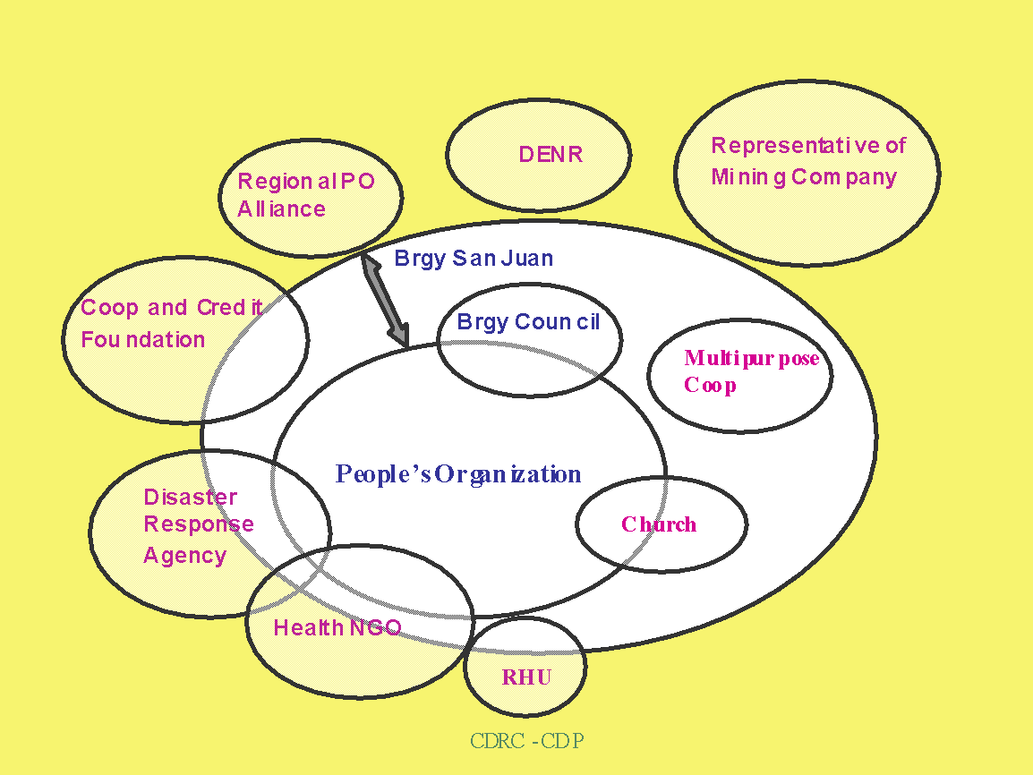
Different Tools Used for Risk Assessment | Seasonal Institutional and Social Network Analysis using Venn Diagram: Example
Viz. notes:
Frame: 13
Slide 1 of 1
Layout Name: Recreate Chart
External Image: Recreate from source ppt.
Treatment:
This chart needs to be recreated. Make sure the text looks clean. Sync the chart with audio.
Note to the Client: Please help us elaborate the chart by adding audio text to the notes section.
Notes:
<AX1> Here is how to represent the Institutional and Social Network Analysis using a Venn diagram.

Slide 31
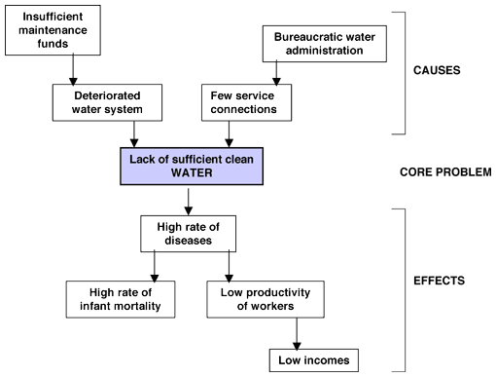
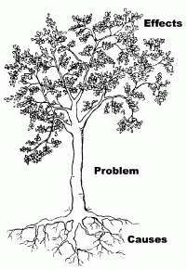
Different Tools Used for Risk Assessment | Problem Tree
Viz. notes:
Frame: 14
Slide 1 of 1
Layout Name: Recreate Chart
External Image:
Treatment:
This chart needs to be recreated. Make sure the text looks clean. Sync the tree with AX1.
Next, show the green circle part in the image with AX2. Remove the circle that is just for indication.
Then show AX3 with the causes part. While sync AX4 with the causes part.
Note to the Client: Is this Vulnerability Capacity Assessment. What is CVA?
Notes:
<AX1> Another tool that can be used in VCA, is the problem tree. Here is an example.
<AX2> Here the participants identify the problem or effect and place at the top of the tree.
<AX3> Then the participants are requested to identify the direct causes of the problem and place each in one of the main branches of the tree.
<AX4> The last step is to identify the root causes of the direct causes and place them in the roots of the tree. There maybe multiple layers of the causes till we reach the root causes.

Slide 32
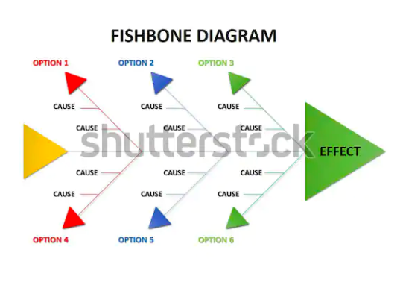
Different Tools Used for Risk Assessment | Fish Bone
Viz. notes:
Frame: 15
Slide 1 of 1
Layout Name:
External icons:
https://www.shutterstock.com/image-illustration/fishbone-diagram-one-method-find-out-1022479735
Notes:
<Ax1> Now comes the Fishbone Diagram, there will be many possible causes. You need to reduce this to a small number that you can address.

Slide 33

Different Tools Used for Risk Assessment | Historical Profile
Viz. notes:
Frame: 16
Slide 1 of 1
Layout Name: Image and Content
External Image:
https://stock.adobe.com/in/images/historical-yield-n-statistics-business-laptop-in-the-office-with-term-on-the-screen-finance-economy/335902937
Treatment:
Please sync image with AX1. Please change the word Yield to Profile in the image. Use AX2 with the OST.
Historical Profile collects information about the past.
Notes:
<AX1> Next comes the Historical Profile. <AX2> As the name suggests, the tool collects information about the past.
[AX3] Let’s understand the process used for historical profiling.

Slide 34



Different Tools Used for Risk Assessment | Historical Profile: Process
Viz. notes:
Frame: 17
Slide 1 of 5
Layout Name: create as is
External Image:
https://t4.ftcdn.net/jpg/02/51/98/69/240_F_251986978_k6PwEoMjNOGePE9jwB0VLqqmPsOwGqWq.jpg
https://t3.ftcdn.net/jpg/03/04/45/90/240_F_304459093_VZKot3kNIUBsHpcZg8iUangGGzJm7U9T.jpg
https://t4.ftcdn.net/jpg/01/06/04/49/240_F_106044912_VYrdqYSCYafieWjbdqkk2htDLScdSEjn.jpg
Treatment:
Please sync the what image with AX1.
Sync the other 2 images with AX2.
Notes:
<AX1> The first step in this process is to know what you need.
<AX2> In this tool, you need to gather all the information about what happened in the past.

Slide 35

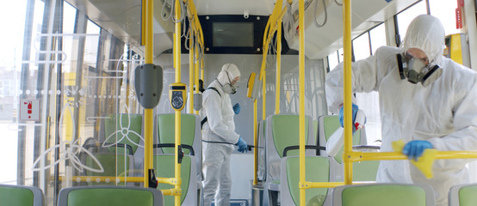
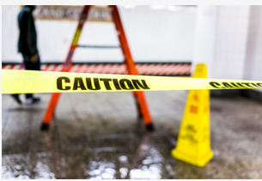
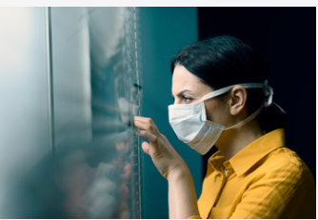
Different Tools Used for Risk Assessment | Historical Profile: Process
Viz. notes:
Frame: 17
Slide 2 of 5
Layout Name: create as is
External Image:
https://t4.ftcdn.net/jpg/02/51/31/95/240_F_251319594_iO4n7K5pTeEVRkFf0mqjj6RE8onEHuMq.jpg
https://t4.ftcdn.net/jpg/03/31/88/55/240_F_331885560_raEfuWHrQtxDByxzyHhkb8qiVLcFmyPT.jpg
https://t3.ftcdn.net/jpg/01/94/04/56/240_F_194045659_zVwk2YF7H62h9VTD3y7wLjOQrNw2mUHc.jpg
Treatment:
Please sync the why image with AX3.
Sync the images and OST from left to right with AX4 to AX6.
Historical Profile gives an insight into the past hazards, changes in their nature, intensity, and behaviour.
Notes:
<AX3> Next comes why do we need it.
<AX4> The historical profile is needed to get an insight into the past hazards, changes in their nature, intensity, and behaviour.
<AX5> It also helps to understand the present situation in community between hazards and vulnerabilities.
<AX6> Lastly, to make people aware of the changes.

Slide 36


Different Tools Used for Risk Assessment | Historical Profile: Process
Viz. notes:
Frame: 17
Slide 3 of 5
Layout Name: create as is
External Image:
https://t3.ftcdn.net/jpg/00/67/68/52/240_F_67685288_NIVczDcLoE9XVJiPuyuy9REQ10oi8cPL.jpg
Treatment:
Sync the images and OST with AX7.
Historical Profile should be taken at the initial phase.
Notes:
<AX7> If you think, when to take up historical profile as assessment tool, then the answer is at the initial phase.

Slide 37



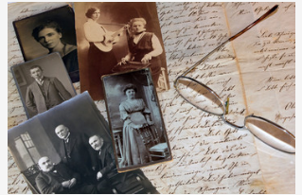

Different Tools Used for Risk Assessment | Historical Profile: Process
Viz. notes:
Frame: 17
Slide 4 of 5
Layout Name: create as is
External Image:
https://t4.ftcdn.net/jpg/02/51/98/67/240_F_251986761_IL8dgqgwGXn5rMZodNVnENZGxf4eR3ca.jpg
https://t3.ftcdn.net/jpg/02/28/60/26/240_F_228602615_YpZxxoVQ5zLUqeDzyLKyE09dBCddbg90.jpg
https://t3.ftcdn.net/jpg/00/39/54/80/240_F_39548004_n3ZrLXV7Daw954khRd3PI3KvlmjuedrH.jpg
Treatment:
Please sync the how image with AX8.
Sync the images and OST starting from left to right.
Sync AX9 with first image and OST on left. Similar for other three. AX9-AX12 should be bulleted.
Plan a group discussion between key informants such as old people, leaders, and teachers.
Invite young people to know about the history of their community.
Recall major events in the community.
List all the events on a blackboard.
Notes:
<AX8> The biggest challenge lies in planning how to do historical profiling. Then these are the steps to be taken while doing historical profiling.
<AX9> Start by planning a group discussion and ensure that key-informants such as old people, leaders, and teachers are present.
<AX10> Invite as much people as possible, especially the young ones, for them to hear the history of their community.
<AX11> Ask people if they can recall major events in the community, such as:
Major hazards and their effects;
Changes in land use;
Changes in land tenure;
Changes in food security and nutrition;
Changes in administration and organization; and
Major political events.
<AX12> The facilitator can write the stories on a blackboard or craft paper in a chronological order.

Slide 38
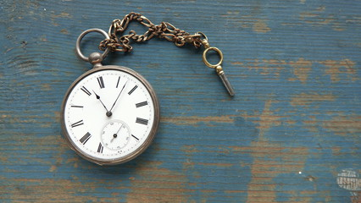
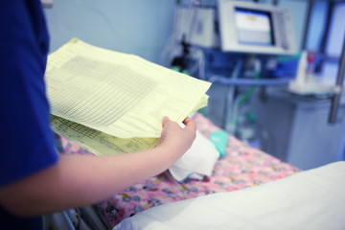
Different Tools Used for Risk Assessment | Historical Profile: Process
Viz. notes:
Frame: 17
Slide 5 of 5
Layout Name: create as is
External Image:
https://t4.ftcdn.net/jpg/02/78/98/25/240_F_278982525_8jqGR1Wk8wQyHE2sf0Ngy7x0gAXRuabs.jpg
https://t4.ftcdn.net/jpg/01/90/11/99/240_F_190119952_RVGbKl1geTBZIswgtRG60rYWAdFejuj1.jpg
Treatment:
Keep the how image there. Fade the other images. Sync the OST in blue boxes with AX13 starting from left to right.
Now, appear the image an OST with AX 14.
Second image with OST and AX15.
Life Histories
History Tracking
Detailed account of their life or regarding a specific issue from a historical perspective.
Find out the reasons that contributed to the occurrence of the experience.
Notes:
<AX13> Apart from these, the two other ways are Life Histories and History Tracking.
<AX14> In Life History, individual informants are required to give a detailed account of their life or regarding a specific issue from a historical perspective.
<AX15> While in History Tracing, individuals or groups start with the current experiences and go back in time. The idea is to find the reasons that contributed to the occurrence of the experience.

Slide 39
Different Tools Used for Risk Assessment | Ranking
Viz. notes:
Frame: 18
Slide 1 of 2
Layout Name: Animation
External Image:
Treatment:
Show the smart art or use the info graphic template. Sync the info graphic with AX1. Feel free to use any other layout.
What
Ranking
Who
Why
Notes:
<AX1> Ranking is another risk assessment tool. It is rather simpler than its counterparts.

Slide 40
Different Tools Used for Risk Assessment | Ranking
Viz. notes:
Frame: 18
Slide 2 of 2
Layout Name: Animation
Treatment:
Show the OST in sync with audio.
Prioritize issues and concerns.
What
It is best that a team facilitates community meeting.
Ranking
The problems, risks, and solutions concerns might not be common for the entire community.
Who
Why
Notes:
<AX2> Start by understanding what needs to be done. This is the best tool to prioritize issues and concerns.
<AX3> Then next comes, why do you need ranking. Ranking is important because the problems, risks, and solutions concerns might not be common for the entire community. They may differ because perceptions differ according to class, gender religion, and ethnicity.
<AX4> Lastly, it is important to decide who takes up ranking. It is best that a team facilitates community meeting. Although ranking can also be done in sub-groups.

Slide 41



Different Tools Used for Risk Assessment | Semi-structured Interviews (SSI)
Viz. notes:
Frame: 19
Slide 1 of 2
Layout Name: Image and Text
External Image:
https://t4.ftcdn.net/jpg/03/04/75/71/240_F_304757150_ZiX3DQDadV0RkjEGYmh3uXpKy8ovPwqp.jpg
https://t4.ftcdn.net/jpg/03/05/42/69/240_F_305426938_4Fj3ZHDG6gXMtagUhGk0ZOlL1mr6LtoG.jpg
https://t3.ftcdn.net/jpg/00/02/40/62/240_F_2406244_ZTzrj7qrbyLrNX4noYZaxyzMNX4IoT.jpg
Treatment: Show the image on the left with first sentence of AX1. Show the OST with second sentence of AX1. Then the right images with AX2.
Discussions in an informal and conversational way
Notes:
<AX1> Let us know about Semi-structured Interviews or SSI. SSI are discussions in an informal and conversational way.
<AX2> SSI do not use formal questionnaire but at the most a checklist of questions as a flexible guide.

Slide 42
Different Tools Used for Risk Assessment | Semi-structured Interviews (SSI)
Viz. notes:
Frame: 19
Slide 2 of 2
Layout Name: Image and Infographic
Treatment: Fade the images. Then show the OST with AX3.
Discussions in an informal and conversational way
Vulnerabilities
Problems
Perceptions
General or Specific Information
Capacities
Notes:
<AX3> SSI helps to get general and specific information, to analyze problems, vulnerabilities, capacities, and perceptions to discuss plans.

Slide 43

Different Tools Used for Risk Assessment | Semi-structured Interviews (SSI): Characteristics
Viz. notes:
Frame: 20
Slide 1 of 1
Layout Name: Image and Content
External Image:
https://as2.ftcdn.net/jpg/00/64/30/15/500_F_64301509_SA5ZMf1oqlU2jiU9U7pypO6Tb7FXvmmD.jpg
Treatment: Show the image along with the AX1. While sync the OST with the bullet pointers.
The different types of SSI include:
Group Interviews
Individual Interview
Key-Informant Interview
Focus Group Discussion
Notes:
<AX1> Now, let us learn about the different types of SSI’s.
Group Interviews;
Individual Interview;
Key-Informant Interview; and
Focus Group Discussion.
Let us know each one in detail.

Slide 44

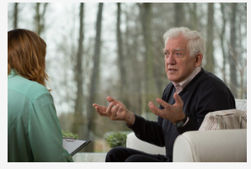


Different Tools Used for Risk Assessment | Semi-structured Interviews (SSI): Types
Viz. notes:
Frame: 21
Slide 1 of 1
Layout Name: create as is
External Image:
https://t4.ftcdn.net/jpg/03/18/19/27/240_F_318192747_UpFPSPygeRAlKpCuvfZ996JUfXD10bVL.jpg
https://t3.ftcdn.net/jpg/02/71/56/18/240_F_271561808_c6wTuD7BrdtSvPVoax9h6Y3hVJ99LVan.jpg
https://t3.ftcdn.net/jpg/00/82/59/10/240_F_82591068_0rNhjkzy2B2a49v0YTM2d38uu7vC17Kr.jpg
https://t3.ftcdn.net/jpg/02/88/81/22/240_F_288812229_bC3WWKGRY7Vf5nXvuNJvfIpLuMNYwHLN.jpg
Treatment: Please sync the OST with the corresponding audio.
Key-Informant Interview obtain special knowledge about a topic.
Group Interviews help to obtain community level information.
Focus Group Discussion helps to discuss specific topics in detail with a small group of persons.
Individual Interview reveals conflicts within community.
Notes:
<AX2> The Group Interviews help to obtain community level information, to have access to a large body of knowledge, not useful for sensitive issues.
<AX3> Individual Interview obtains representative and personal information. It may reveal differences or conflicts within community.
<AX4> Key-Informant Interview obtain special knowledge about a topic. Examples include interviewing a nurse to know more about epidemics, interviewing a farmer about cropping practices, and a village leader about procedures and policies.
<AX5> Focus Group Discussion helps to discuss specific topics in detail with a small group of persons who are knowledgeable or who are interested in the topic. People can also be grouped according to gender, age, and owners of resources.

Slide 45

Different Tools Used for Risk Assessment | Direct Observation
Viz. notes:
Frame: 22
Slide 1 of 5
Layout Name: 4 Tab Interactivity
External Image:
https://t3.ftcdn.net/jpg/03/19/38/52/240_F_319385260_4aoRXAnf6WYDtt31SvVzsviF4PSSNTDH.jpg
Treatment:
Sync the image with ax1.
Please show the tabs in sync with AX2.
What
Why
Who
How
Click each tab to know more.
Notes:
<AX1> Moving ahead, let’s learn about Direct Observation.
<AX2> It is easier to summarize the tool in four major questions: What, Why, Who and How.
[IAX]
Click each tab to know more.

Slide 46
Different Tools Used for Risk Assessment | Direct Observation
Viz. notes:
Frame: 22
Slide 2, 3, 4, 5 of 5
Treatment: As the user clicks, show all the text as listed in the tabs. Make sure one tab closes when the other opens.
What
Systematically observing objects, people, events, relationships, participation, and recording these observations.
Why
Direct Observation helps to get a better picture of the situation, especially of things that are difficult to verbalize. It also helps to cross-check verbal information. Observations are analyzed afterwards; women participate in community meetings.
Who
Everybody can participate in the activity.
How
Think about the purpose of why you are in the community, and identify indicators, which you can assess through direct observation. These will make up your checklist.
Click each tab to know more.

Slide 47

Different Tools Used for Risk Assessment | Transect Walk
Viz. notes:
Frame: 23
Slide 1 of 3
Layout Name: create as is
External Image:
https://stock.adobe.com/in/images/the-word-or-phrase-transect-in-a-dictionary/309383792
Treatment:
Sync the image with ax1.
Notes:
<AX1> Let us know about Transect Walk as a risk assessment tool.

Slide 48

Different Tools Used for Risk Assessment | Transect Walk
Viz. notes:
Frame: 23
Slide 2 of 3
Layout Name: create as is
External Image:
https://www.shutterstock.com/image-photo/five-hand-drawn-light-bulbs-representing-1121696642
Treatment:
Fade the BG image from the previous slide. Now, show the image on the left in sync with the audio “Transect walk with key-informants of the community helps to explore spatial differences or land use zones “. Show the rest of the text with the corresponding OST.
Observing
Asking
Listening
Producing
Notes:
<AX2> Systematic Walk with key-informants of the community helps to explore spatial differences or land use zones by observing, asking, listening, and producing a transect diagram.

Slide 49
Different Tools Used for Risk Assessment | Transect Walk
Viz. notes:
Frame: 23
Slide 3 of 3
Layout Name: Please use the infographic template. Slide 29
External Image:
https://t4.ftcdn.net/jpg/01/23/24/61/240_F_123246138_TodFvWggh4AhYrahAfxdMizhT2X46Q2Q.jpg
Treatment:
Keep the BG image same from the previous slide. Now show the info graphic in sync with AX3 in the centre. The other OST with AX4 to AX6.
Visualize interactions between physical environment and human activities.
Why do we need Transect Walk?
Identify danger zones, evacuation sites, local resources used during emergency periods.
Seek problems and opportunities
Notes:
<AX3> But, why do we need Transect Walk. Using Transect Walk as a tool helps to:
<AX4> Visualize interactions between physical environment and human activities over space and time;
<AX5> Identify danger zones, evacuation sites, local resources used during emergency periods, land use zones, etc; and
<AX6> Seek problems and opportunities.

Slide 50
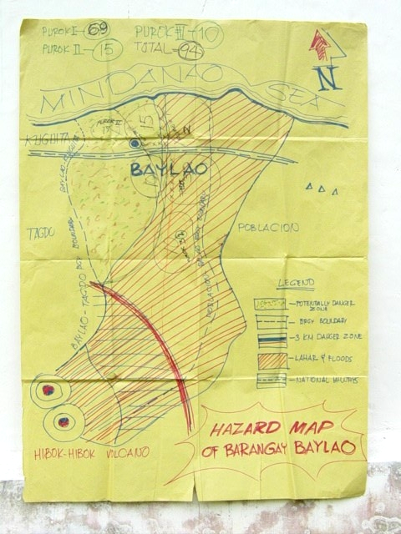
Different Tools Used for Risk Assessment | Community Sketch
Viz. notes:
Frame: 24
Content Slide
Slide 1 of 3
Layout Template:
No layout available
External Image:
From source ppt
Treatment:
Please recreate the image with AX1.
Notes:
<AX1> Community sketch is pretty similar to the VCA map. Community sketch is the area’s map and identify different hazards (sources of risks) that might affect their community.

Slide 51

Participatory Community Risk Reduction Planning | What to plan?
Viz. notes:
Frame: 24
Content Slide
Slide 2 of 3
Layout Template:
No layout available
External Icons:
https://stock.adobe.com/in/search/images?k=andsearch_type=empty-carousel-asset-clickandasset_id=335920355
Treatment:
Please show the image with AX2.
Different Tools Used for Risk Assessment | Community Sketch
Notes:
<AX2> The exercise is usually done by group members with different background.

Slide 52

Participatory Community Risk Reduction Planning | What to plan?
Viz. notes:
Frame: 24
Content Slide
Slide 3 of 3
Layout Template:
No layout available
External Icons:
https://stock.adobe.com/in/search/images?k=andsearch_type=empty-carousel-asset-clickandasset_id=334592650
Treatment:
Please show the image with AX3.
Different Tools Used for Risk Assessment | Community Sketch
Notes:
<AX3> The exercise is guided by a facilitator.

Slide 53
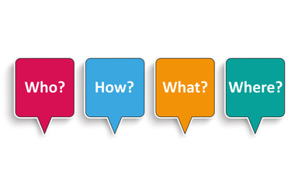

Different Tools Used for Risk Assessment | Visioning: Process
Viz. notes:
Frame: 25
Slide 1 of 1
Layout Name: Slide 39-40.
External Image: https://stock.adobe.com/in/images/4-speech-bubbles-who-how-what-where/92505934
Treatment: As the user clicks show all the text as listed. Please sync the OST and the images along with the corresponding audio. The chart tabs need to be placed in the correct sequence as shown below.
WHAT:
WHY:
WHEN:
WHO:
HOW:
The audio needs to be synced in the same way and the OST too.
WHY?
When?
Assisting the community develop a model for the increased safety of their community, based on the results of VCA in their community
Understanding of how the community members themselves feel the safety of their community can be improved and which areas are perceived to be more or less important to them.
The collated and analysed data obtained during VCA has been presented to the community.
Community members facilitated by VCA field practitioners.
Analysing the findings of the VCA.
Notes:
<AX1> Next, let’s learn about Visioning. Visioning helps to assist the community to develop a model for the increased safety of their community, based on the results of VCA in their community.
<AX2> It helps to gain a thorough understanding of how the community members themselves feel the safety of their community can be improved. Also, which areas are perceived to be important to them.
<AX3> Visioning is done after the collated and analysed data obtained during VCA has been presented to the community.
<AX4> It is done by the community members facilitated by VCA field practitioners.
<AX5> It is done by analysing the findings of the VCA, ‘dreaming and drawing’ the safer community of the future.

Slide 54

Different Tools Used for Risk Assessment | Check Your Understanding
Visualisation notes:
Frame: 26
CYU: Drag and Drop
This is slide 1 of 2
Layout Name: Drag and Drop
https://t3.ftcdn.net/jpg/01/31/47/72/240_F_131477232_WNiM1zEVOpJtDWgn6LyTfSjjh9CVc8sz.jpg
Treatment: Allow the image to load and question with relevant text boxes to load from the start. Allow the user to drag the boxes on the left into boxes in the right. The text should be
Correct Answer:
As shown in next slide.
Match the following Risk Assessment Tools with the corresponding statements?
Starts with identification of general information at the community level and scales down to the household and individual levels.
Mapping
VCA
The assigned VCA group draws a map profile of their areas to identify different vulnerable factors and available resources.
.
Transect Walk
Identify organizations and their role along with the people’s perception about them.
Historical Profile
An insight into the past hazards, changes in their nature, intensity, and behaviour.
Ranking
Visualize interactions between physical environment and human activities over space and time.
Institutional and Network Social Analysis
The problems, risks, and solutions concerns might not be common for the entire community. They may differ because of the perceptions.
Drag and drop the tools to their description, and click Submit.
Submit
Notes:
<AX1>
It’s time to check your understanding of the concepts we have covered.

Slide 55
Different Tools Used for Risk Assessment | Check Your Understanding
Visualisation notes:
Frame: 26
Slide 2 of 2
Correct Answer:
When the user clicks Submit. Show correct answers like this. Show the feedback. “ Correct!” In case the answer is correct. In case of incorrect, use the standard verbiage “Incorrect!”.
Starts with identification of general information at the community level and scales down to the household and individual levels.
VCA
The assigned VCA groupsdraws a map profile of their areas to identify different vulnerable factors and available resources.
Transect Walk
.
Institutional and Network Social Analysis
Identify organizations and their role along with the people’s perception about them.
Historical Profile
An insight into the past hazards, changes in their nature, intensity, and behaviour.
Mapping
Visualize interactions between physical environment and human activities over space and time.
Ranking
The problems, risks, and solutions concerns might not be common for the entire community. They may differ because of the perceptions.
Submit

Slide 56

Summary
Visualisation notes:
Frame: 27
Slide: 1
Layout: Summary Screen
Treatment: Show image and text , allow each sentence to appear one after another.
https://t3.ftcdn.net/jpg/03/26/15/76/240_F_326157640_rdoJXIW2AbKTMdrQ5V56LrLNWOvo9lar.jpg
Let us summarize all that you have learned.
The VCA starts with identification of general information at the community level and scales down to the household and individual levels.
In Mapping, the community members and the assigned VCA group with the facilitation of experts, draw a map profile of their areas to identify different vulnerable factors and available resources.
The seasonal calendar shows different events, experiences, activities, conditions throughout the annual cycle.
The Institutional and Social Network Analysis using VENN Diagram shows key-organizations, groups, and individuals in a community and their nature of relationship and level of importance.
The participants identify the problem and place it in different parts of the tree.
The historical profile is needed to get an insight into the past hazards, changes in their nature, intensity, and behaviour.
Ranking is important because the problems, risks, and solutions concerns might not be common for the entire community.
Semi Structured Interviews are discussions in an informal and conversational way. It does not use formal questionnaire but at the most a checklist of questions.
Direct Observation is systematically observing objects, people, events, relationships, participation, and recording these observations.
Systematic Walk with key-informants of the community helps to explore spatial differences or land use zones by observing, asking, listening, and producing a transect diagram.
Community sketch is the area’s map and identify different hazards that might affect their community.
Visioning helps to gain a thorough understanding of how the community members themselves feel the safety of their community can be improved.
Notes:
<AX1>
That brings us to the end of the Participatory Risk Assessment Tools session. Let us summarize all that you have learned.
The VCA starts with identification of general information at the community level and scales down to the household and individual levels.
In Mapping, the community members and the assigned VCA group with the facilitation of experts, draw a map profile of their areas to identify different vulnerable factors and available resources.
The seasonal calendar shows different events, experiences, activities, conditions throughout the annual cycle.
The Institutional and Social Network Analysis using VENN Diagram shows key-organizations, groups, and individuals in a community and their nature of relationship and level of importance.
The participants identify the problem and place it in different parts of the tree.
The historical profile is needed to get an insight into the past hazards, changes in their nature, intensity, and behaviour.
Ranking is important because the problems, risks, and solutions concerns might not be common for the entire community.
Semi Structured Interviews are discussions in an informal and conversational way. It does not use formal questionnaire but at the most a checklist of questions.
Direct Observation is systematically observing objects, people, events, relationships, participation, and recording these observations.
Systematic Walk with key-informants of the community helps to explore spatial differences or land use zones by observing, asking, listening and producing a transect diagram.
Community sketch is the area’s map and identify different hazards that might affect their community.
Visioning helps to gain a thorough understanding of how the community members themselves feel the safety of their community can be improved.

Slide 57
Session Completed
Visualisation notes:
Frame: 28
This is a Static screen
This is slide 1 of 1
Layout:
Image should be same as Session Title screen.
https://www.shutterstock.com/image-photo/image-tangram-puzzle-blocks-people-icons-1149593039
Treatment:
All elements appear on screen load. On clicking Exit Course, the learner exits the course ad on clicking Restart Course, the learner goes back to Frame 1.
Congratulations, you have successfully completed the Participatory Risk Assessment Tools session.
.
Restart Session
Exit Session
Notes:
<AX1>
Congratulations, you have successfully completed the Participatory Risk Assessment Tools session.
<IAX>
Click the Exit Session button to close the window or the Restart Session button to take the session again.

